Slide 1
Nova Pay Customer Segmentation Report A practical look at customer behaviour and value using RFM analysis Prepared by: Brume Pascal Date: July 2025

Slide 2
Executive Summary
NovaPay is a fast-growing digital payments and customer wallet platform, serving thousands of users with mobile transactions, transfers, and subscriptions. As the user base grew, it became harder to distinguish between high-value users, loyal transactors, and those likely to churn.
This project used RFM (Recency, Frequency, Monetary) analysis and Customer Lifetime Value (CLV) calculations to segment customers based on their transaction behaviour.
Identify the most valuable and active customer groups
Spot customers who were disengaging or at risk of churn
Align messaging and offers to each customer group
Improve campaign ROI through smart segmentation
As a result, Nova now has a data-driven foundation for customer retention, engagement, and smarter marketing decisions.

Slide 3

Problem Context
Nova had been experiencing a steady rise in customers and transactions, but beneath the surface, signs of churn and disengagement were becoming evident.
- Many customers were inactive or unresponsive to marketing efforts.
- Campaigns were generic, and resources were spread too thinly across all customer types.
Challenge: "How do we know who matters most?“
This project answers that question by giving structure to customer value.

Slide 4
Project Objectives
Segment Nova customers using RFM scoring
1
Calculate estimated CLV to gauge long-term value
2
Identify segments worth prioritizing
3
Assign campaign strategies per segment
4
Recommend actions to retain high-value customers and revive disengaged ones

Slide 5
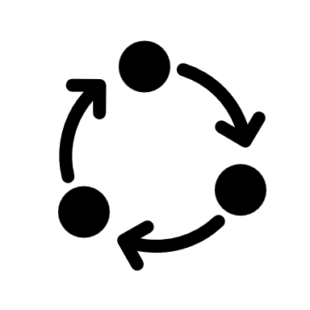
Methodology
What is RFM?
RFM analysis groups customers based on
Recency: How recently they transacted
Frequency: How often they transact
Monetary: How much they spend
- Each customer receives a score from 1–5 in each category. These scores form a segment profile (e.g., 555 = top performer in all three).
- We also calclated Customer Lifetime Value (CLV) as a future-facing metric using this formula:
- Note: Small values were added to avoid division by zero when needed.

Slide 6
RFM Segment Output Sample: From Raw Data to Targeted Campaigns
Customer ID | Recency | Frequency | Monetary | R Score | F Score | M Score | RFM Score | Segment | Campaign Target
C1010011 | 25 | 2 | 5106.0 | 5 | 5 | 5 | 555 | Champions | VIP Program
C1010012 | 68 | 1 | 1499.0 | 2 | 1 | 4 | 214 | Hibernating | Reactivation Email
C1010014 | 75 | 2 | 1455.0 | 1 | 5 | 4 | 154 | At Risk | Win back Campaign
C1010018 | 36 | 1 | 30.0 | 5 | 1 | 1 | 511 | New | Onboarding Sequence

Slide 7
Customer ID | Recency | Frequency | Monetary | R Score | F Score | M Score | RFM Score | Segment | Campaign Target
C1010024 | 64 | 1 | 5000.0 | 2 | 1 | 5 | 215 | Hibernating | Reactivation_Email
C1010028 | 53 | 1 | 557.0 | 3 | 1 | 3 | 313 | Others | Low Priority
C1010031 | 78 | 2 | 1864.0 | 1 | 5 | 4 | 154 | At Risk | Wingback Campaign
C1010035 | 55 | 2 | 750.0 | 3 | 5 | 3 | 353 | Loyal | Exclusive Deals
This sample demonstrates how individual customer transactions are converted into RFM scores (1-5 scale), automatically assigned to strategic segments, and linked to personalized marketing campaigns. Each customer's recency, frequency, and monetary behaviour determines their segment classification and corresponding retention or growth strategy.

Slide 8
Segment Definitions Based on RFM Scores
Champions (R=5, F=5, M=5):Customers who have purchased very recently, purchase very frequently, and spend the most money. These are your ideal high-value customers with top scores across all RFM dimensions.
Loyal (F=4–5, R=3–4, M=3–4):They buy often and consistently but may not have purchased very recently or spent the highest amounts. High frequency is their strongest trait, with moderate scores in recency and monetary.
At Risk & Hibernating (R=1–2, F=3–5, M=3–4):These customers used to be active (moderate-to-high F and M) but haven’t purchased in a long time (low R). The difference is often in how long ago their last transaction was. Hibernating may be colder than At Risk.
New (R=5, F=1, M=1–2):Customers who made their first or only recent purchase. Their high R score shows they're very recent, but they haven’t yet developed frequency or spend history.
Others (R=1–2, F=1–2, M=1–2):These customers rank low across all RFM dimensions. They buy rarely, spend little, and haven’t been active in a long time , usually low-value or disengaged users.

Slide 9
Customer Segmentation Results
Segment | Customer Numbers | Avg Order Value | Total Revenue (Monetary) | Days Since Last Purchase (Recency) | Avg Orders per Customer (Frequency)
Champions | 88856 | 4523.18 | 401.9M | 39.9 | 1.85
Loyal | 251544 | 1358.23 | 341.7M | 46.9 | 1.24
At Risk | 186858 | 1815.88 | 339.3M | 71.1 | 1.13
Hibernating | 148421 | 1575.62 | 233.9M | 71.5 | 1.00
Big Spenders | 21533 | 7318.97 | 158.0M | 48.5 | 1.00
New | 66150 | 1534.37 | 101.5M | 40.6 | 1.00
Others | 115401 | 480.37 | 55.4M | 48.6 | 1.00

Slide 10
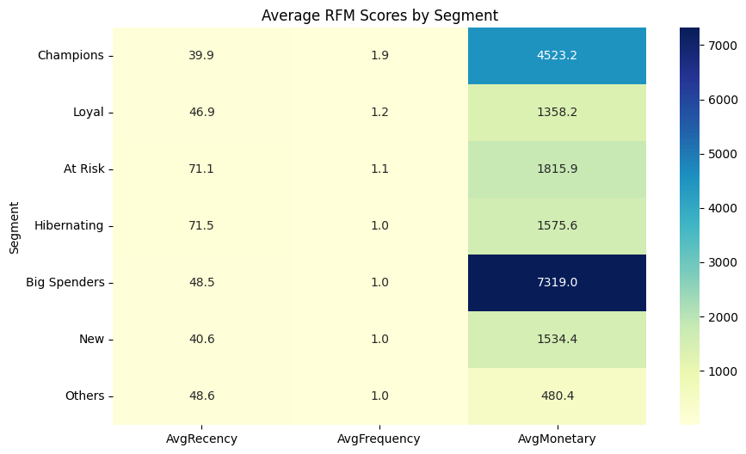
Heatmap : RFM Performance by Customer Segment
Champions excel in monetary value ($4,523 avg) with recent activity, while At Risk and Hibernating segments show critical warning signs with 71+ days since last purchase despite decent spending power.

Slide 11
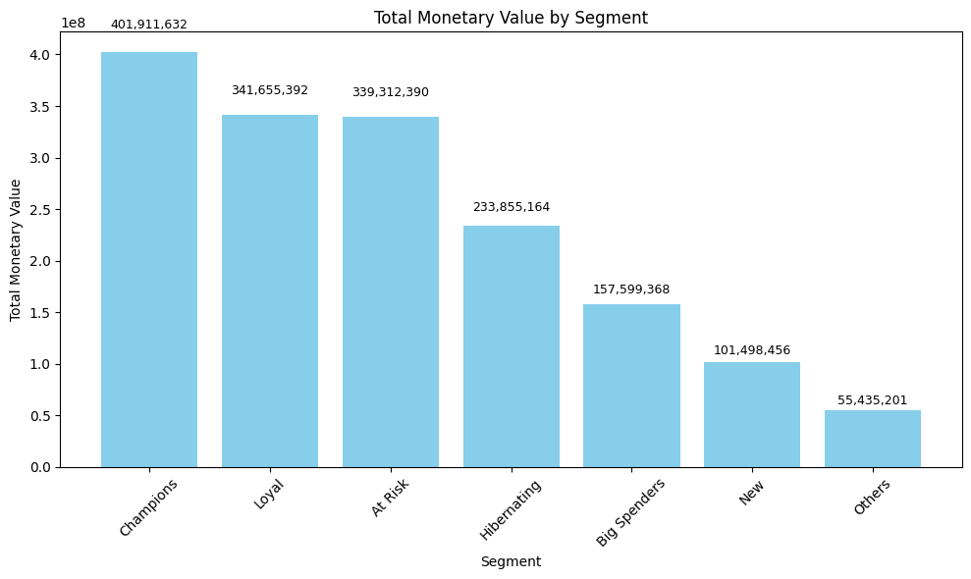
Bar Chart - Total Monetary Value by Segment
Champions, Loyal, and At-Risk segments each contribute ~$340-400M in revenue. Protecting the At-Risk segment is crucial and losing them would eliminate 25% of total revenue.

Slide 12
Key Take ways from RFM
Champions (88K customers) are our most valuable segment - high order values (4,523) and frequent purchases (1.85x/customer)
Loyal customers (251K) represent our largest group with consistent behaviour and strong total revenue (341.7M)
At Risk and Hibernating customers show concerning patterns with 71+ days since last purchase - requiring immediate retention efforts
Big Spenders have the highest order values (7,319) but low frequency, indicating premium but occasional buyers
New customers show promise with recent activity (40.6 days) and potential for growth
Action Priority: Focus retention campaigns on At Risk/Hibernating segments while nurturing Champions and converting New customers to Loyal status.

Slide 13
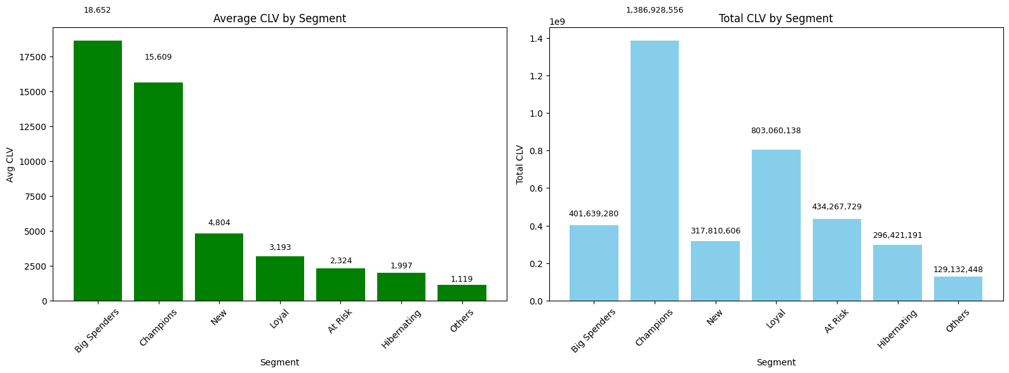
Customer Lifetime Value (CLV) Analysis
Two Critical Perspectives on Customer Value: Individual Value vs. Collective Impact
Average CLV: How much each customer is worth on average
Total CLV: The combined value potential of the entire segment

Slide 14
Key Takeaways from CLV Analysis
Champions have the highest total CLV, making them the most valuable segment overall.
Big Spenders led in average CLV per customer, despite being fewer in number, each customer here is extremely valuable.
Loyal customers generate significant total value due to their volume, even if their individual CLV is moderate.
At Risk and Hibernating segments still contribute considerable revenue and with targeted reactivation, their potential can grow.
New customers show promise, especially with onboarding strategies.
Others have the lowest CLV and may not be worth heavy marketing investment.
⚠️ Note: CLV was estimated using a simplified model assuming a 3-month lifespan. While not exact, it offers a strong comparative view across segments and helps guide strategic decisions

Slide 15
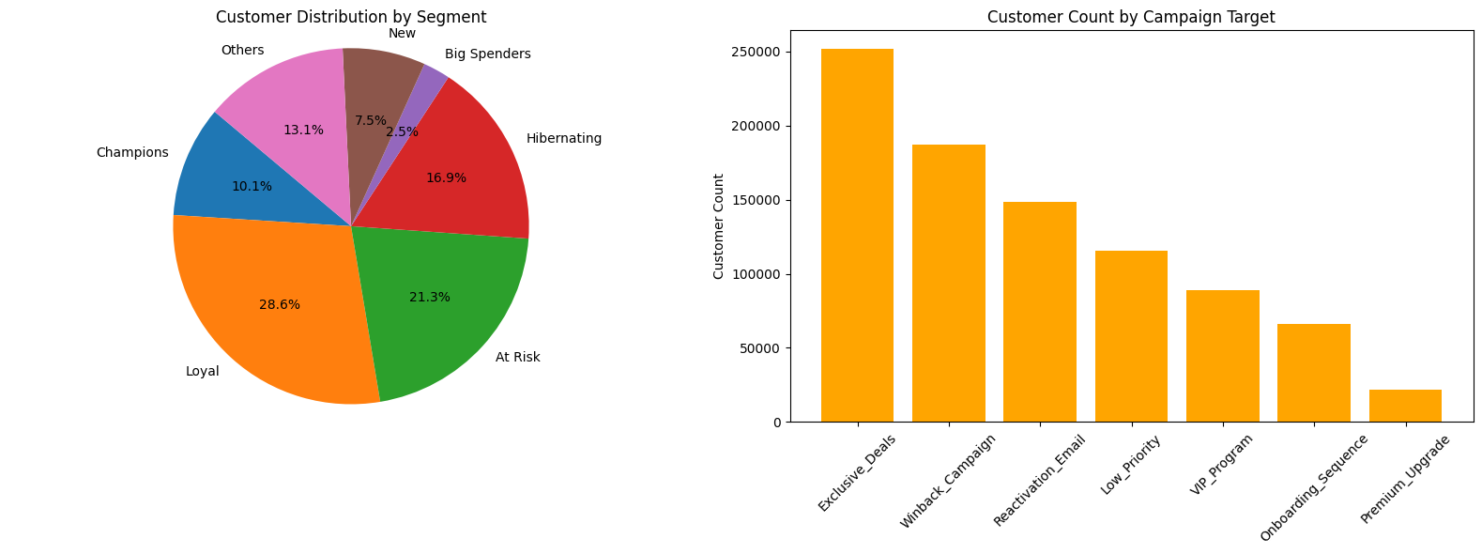
Customer Distribution
The majority of customers belong to the Loyal, At Risk, and Hibernating segments, making them critical for retention and reactivation efforts.
Campaign targeting generally aligns with segment size, although high-value segments like Big Spenders remain small and require focused, personalized strategies.

Slide 16
Campaign Targeting Strategy
We matched each segment to a specific campaign strategy:
Segment | Campaign Target
Champions | VIP Program
Loyal | Exclusive Deals
At Risk | Win back Campaign
Hibernating | Reactivation Email
Big Spenders | Premium Upgrade
New | Onboarding Sequence
Others | Low Priority

Slide 17
Final Insights
Champions and Big Spenders are recent, frequent, and high-spending customers. They drive the highest value per person and should be prioritized with VIP treatment and retention strategies.
The Loyal segment includes customers who buy often, even if their spending is moderate, they're reliable revenue contributors due to their volume.
At Risk and Hibernating customers have not purchased in a while. Although they were once valuable, they now require targeted win-back or reactivation campaigns.
New customers show early potential. With the right onboarding and engagement, they could evolve into Loyal or even Champion status.
The Others segment consists of low-frequency, low-value customers, marketing efforts here should be minimal and cost-effective.

Slide 18
Final Recommendations
Focus on Top Customers
The Champions and Big Spenders are driving the most value so don’t just thank them, reward their loyalty with VIP experiences, early product access, or personalized support. These are the people the business can’t afford to lose.
2. Keep Loyal Customers Coming Back The Loyal segment shops frequently and steadily adds to revenue. Keep them engaged with exclusive deals, bundles, or even a referral program because small nudges go a long way here.
3. Recover Lost Value from Inactive Customers At Risk and Hibernating customers used to be active but haven’t returned in a while. Target them with win-back offers, reminders, or personalized messages. They’ve spent before so there’s still potential.

Slide 19
Continuation
4. Grow New Relationships the Right Way New customers need direction. A simple onboarding flow, welcome email, or first-time discount can turn them into long-term loyal users. Don’t let early momentum go to waste.
5. Be Strategic with Low-Value Segments The Others group shows very low engagement and value. It’s okay to pull back here. time, budget, and campaigns are better spent elsewhere.
6. Use CLV to Guide Marketing Investment Instead of guessing who to spend on, use Customer Lifetime Value (CLV) to shape budget. Spend more where there’s long-term payoff.
7. Automate workflow to Make This Ongoing, Not One-Off Customer behaviour changes. Set up a basic monthly refresh of RFM and CLV scores to keep strategies up to date without starting from scratch every time.

Slide 20
🔚 Wrap-Up
Nova now has a clearer picture of its customer base not just by who they are, but how they behave, engage, and contribute value. With combining RFM segmentation with CLV analysis, we’ve unlocked:
A data-driven way to prioritize marketing and retention
Smart campaign targeting that reflects real customer behaviour
Clear strategies to retain high-value customers, revive lapsed ones, and nurture new relationships
The next step? Automate, and repeat.

Slide 21
Thank you
Opitien Brume Pascal
https://www.linkedin.com/in/pascalbrume/
https://pascalbrume.netlify.app/

